Slide 1
Tracking the embodied dynamics of cognition using computer mouse tracking
Stefan Scherbaum, Martin Schoemann
Interdisciplinary College 2023

Slide 2

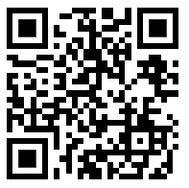
Where can you find the slides?
https://github.com/mschoemann/ik2023_mc2

Slide 3
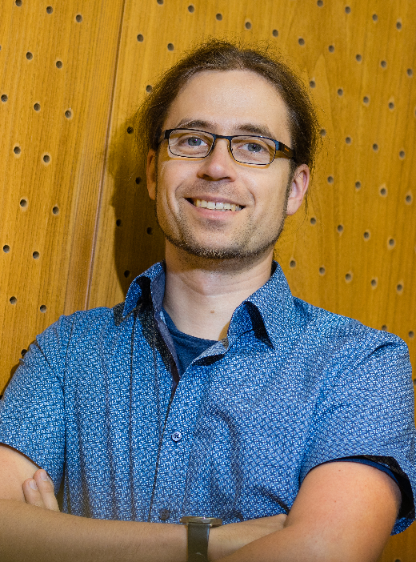

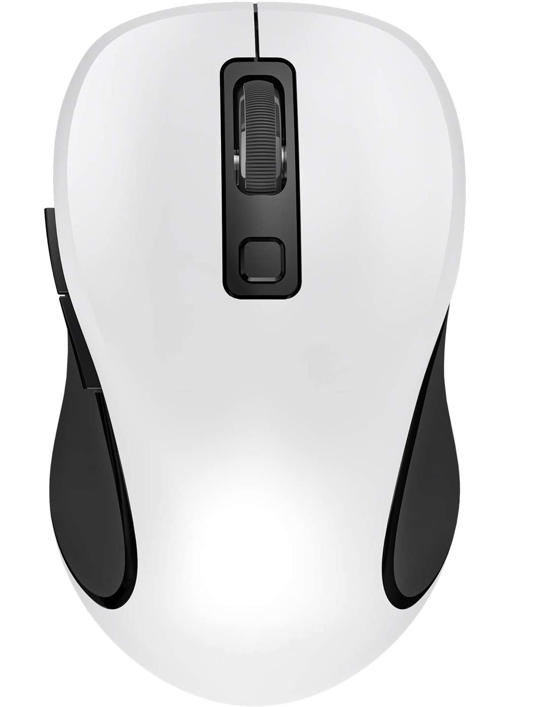
Who are you dealing with?
Stefan Scherbaum
Martin Schoemann
and a very versatile device for behavioral research

Slide 4
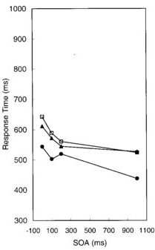

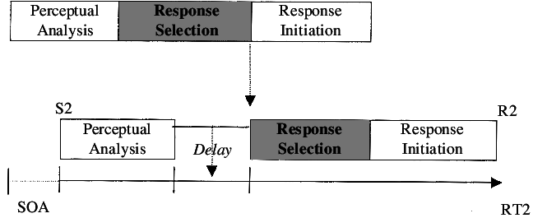

Stage-like linear approaches to cognition → Measures of final response
Infering stage components
from RT and choices
e.g., Lien & Proctor, 2002
e.g., Fellows 2004, Sugrue et al. 2005

Slide 5
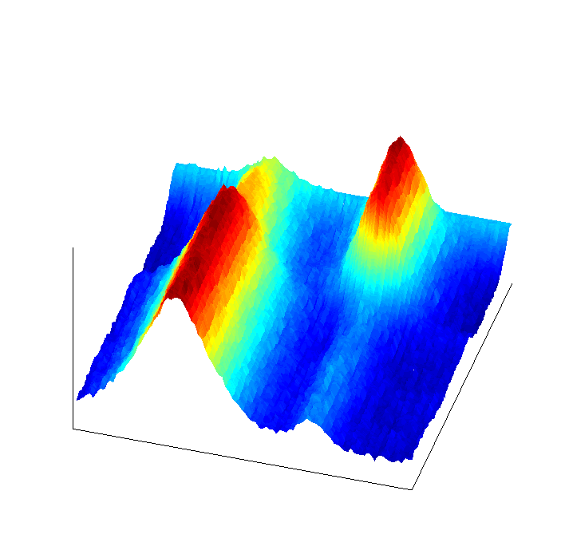
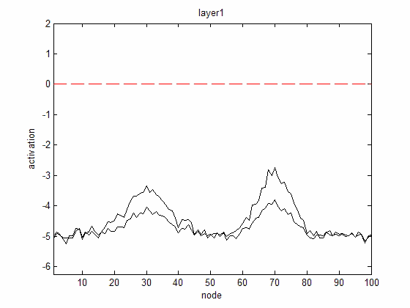
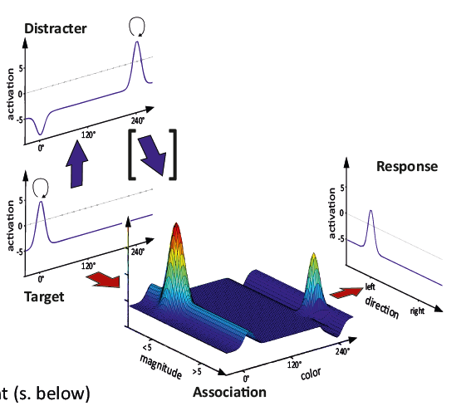
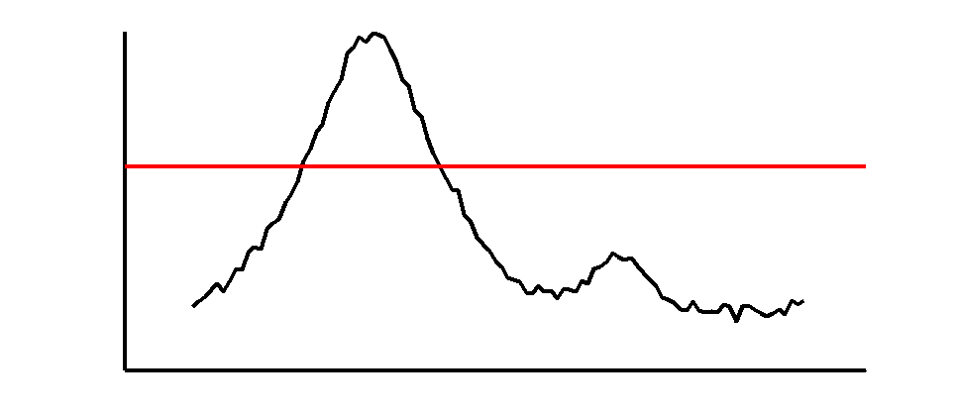
Cognitive processes are inherently dynamic & interconnected & non-linear
activation
time
. . .

Slide 6
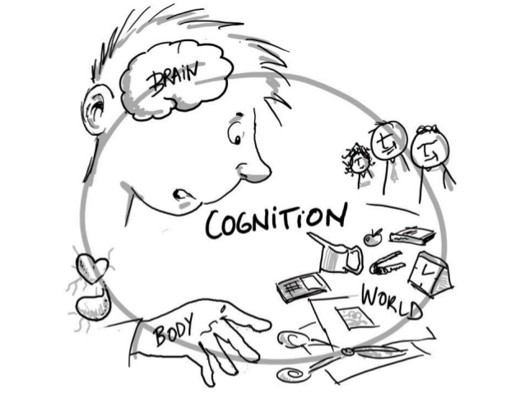
Cognition & embodiment: Thinking and moving in the world are directly connected

Slide 7
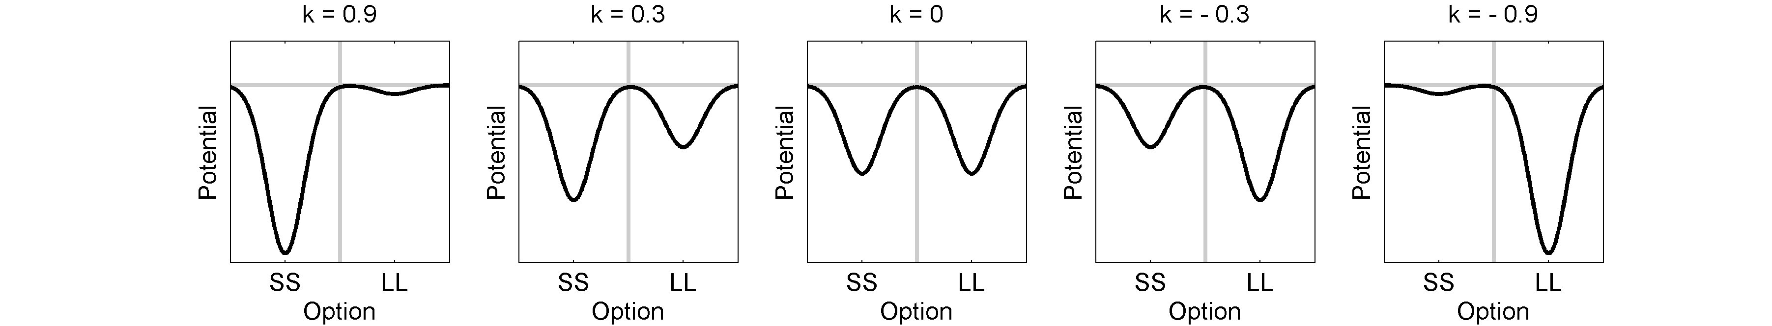
Tracing continuous processes continuously: by studying continuous movements
continuity within trials
continuous tracing of responses
Option 1
Option 2
Energy/Potential
Embodiment: Leakage of cognition into movements
Option
Time
Option
Computer mouse tracking!
Scherbaum, Dshemuchadse, Kalis, 2008

Slide 8
Observing cognitive processes by their „leakage“ into motor control
Spivey & Dale, 2006

Slide 9
A typical mouse tracking paradigm
Two alternative forced choice paradigms as most controlled variant
Example: Intertemporal Choice
2 €
Now
9 €
10 days

Slide 10
A typical mouse tracking paradigm
Two alternative forced choice paradigms as most controlled variant
Example: Intertemporal Choice
clicking to start a trial

Slide 11
A typical mouse tracking paradigm
Two alternative forced choice paradigms as most controlled variant
Example: Intertemporal Choice
starting movement

Slide 12
A typical mouse tracking paradigm
Two alternative forced choice paradigms as most controlled variant
Example: Intertemporal Choice
2 €
Now
9 €
10 days
reaching presentation criterion (speed/time/position)

Slide 13
A typical mouse tracking paradigm
Two alternative forced choice paradigms as most controlled variant
Example: Intertemporal Choice
2 €
Now
9 €
10 days
decision process

Slide 14
A typical mouse tracking paradigm
Two alternative forced choice paradigms as most controlled variant
Example: Intertemporal Choice
reaching response box for final decision
2 €
Now
9 €
10 days

Slide 15
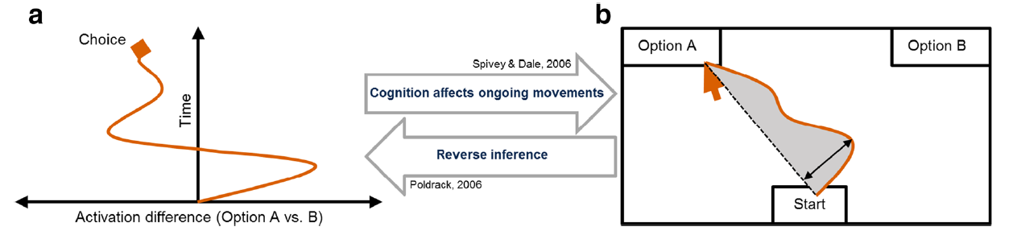
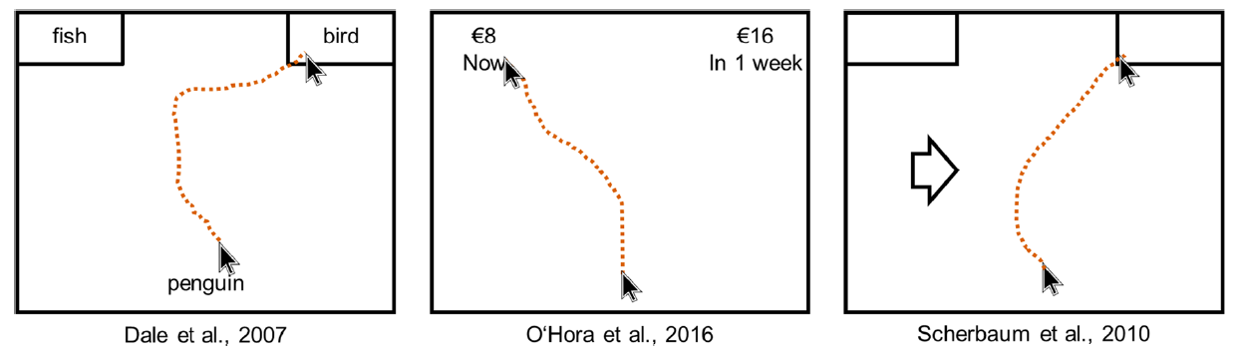
Using mouse tracking to infer processes
Schoemann et al, 2020

Slide 16
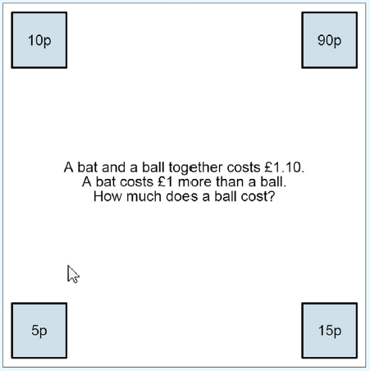
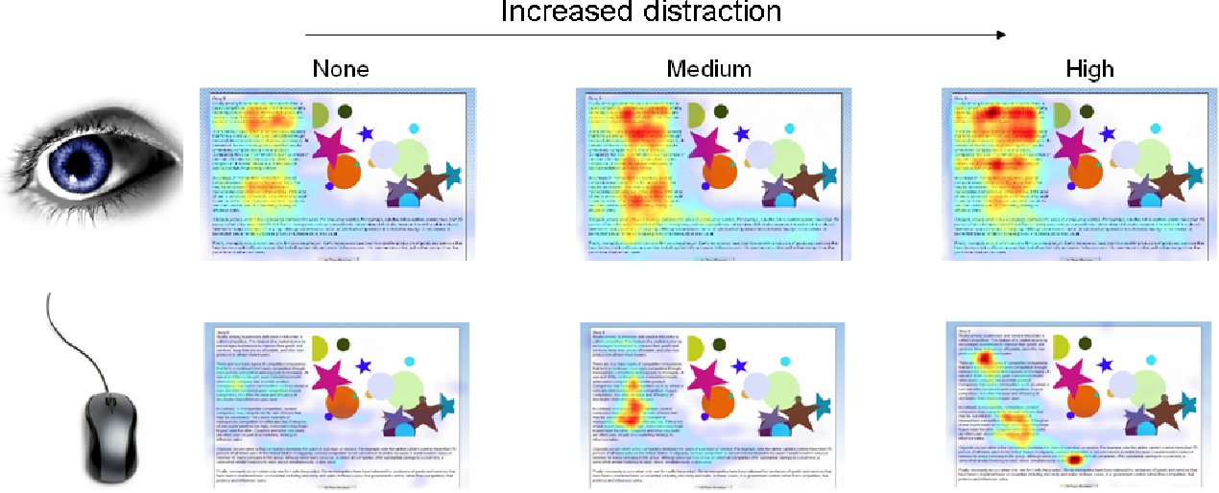
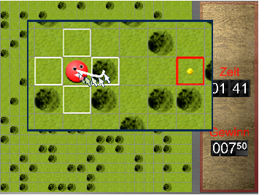
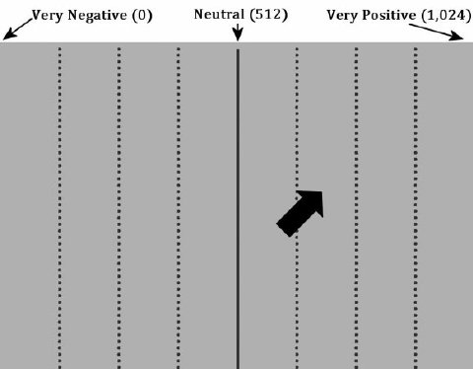
Other types of mouse tracking
More than 2 options Mouse tracking as eye tracking
Micro mouse tracking Long(er) term mouse tracking
Travers, Rolison, Feeney, 2016
Navalpakkam, Churchill, 2012
Scherbaum et al., 2013
Vallacher, Geert, Nowak, 2015

Slide 17
What we will look at today
What will we do in the course?
Where has it been applied?
What can we look at?
What do we need to keep in mind?

Slide 18
Course Syllabus
Introductory lecture (Monday, 14.30-16.00, i.e., now :))
Performing an experiment & discussing your ideas for experiments (Tuesday, 11.00-12.30)
Analyzing mouse-tracking data (Tuesday, 16.30-18.00)
Presentation of your experiment ideas & analysis results (Wednesday, 11.00-12.30)

Slide 19

Course Syllabus
Performing an experiment & discussing your ideas for experiments (Tuesday, 11.00-12.30)
We will present a task
You will perform the task
We will discuss your experimental ideas → Find groups and brainstorm ideas https://drive.google.com/drive/folders/14XsqqMNp_30vliT2osjegT-ocYrxYAVM?usp=sharing
What you need: Laptop with Wifi & Google slides link (OpenSesame installed) (https://osdoc.cogsci.nl/)

Slide 20
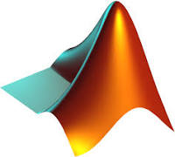

Course Syllabus
Analyzing mouse tracking data (Tuesday, 16.30-18.00)
We will analyze together the data of the measured task
You can dig deeper into the data in groups
What you need: Laptop with Matlab or R installed (https://www.mathworks.com/campaigns/products/trials.html) (https://www.r-project.org/ | https://posit.co/downloads/)

Slide 21
Course Syllabus
Presentation of your experiment ideas & analysis results (Wednesday, 11.00-12.30)
We will see and discuss your short presentations of
Your designed tasks
Your implemented tasks
Your additional results from analysis from Tuesday
What you need: Laptop & Google slides

Slide 22
Course Syllabus
Paths through this course:
The starter package:
Think about a potential experiment and what you might need to consider
Follow the analysis and play around with the provided script(s)
Present your finalized ideas
The data science package
Think about a potential experiment and what you might need to consider
Perform advanced analysis on the data provided
Present your finalized task ideas and your additional results
The experimenter package
Think about a potential experiment and implement it by adapting the provided task
Follow the analysis and play around with the provided scripts
Present your task, have someone test it live;
Extreme: measure a few people and analyze
Notes:
Sehr nice!

Slide 23

What do you pick?
Matlab vs R?
Which package?
https://www.menti.com/al8e1bqphr1d

Slide 24
What we will look at today
What will we do in the course?
Where has it been applied?
What can we look at?
What do we need to keep in mind?

Slide 25
Areas of application Spoken language
Spivey, Grosjean, Knoblich, 2005

Slide 26
Areas of application Stereotypes & face and voice
Freeman & Ambady, 2011

Slide 27
Areas of application Decision making & risk aversion
Koop & Johnson, 2013

Slide 28
Areas of application Decision Making & Status Quo Bias
0 Days
8 Days
9.84 Euro
19.68 Euro
stay
or
switch
?
8 Days
0 Days
19.68 Euro
9.84 Euro

Slide 29
Areas of application Decision Making & Status Quo Bias
SS = soon & small
LL = late & large
→ Stay easier than switch

Slide 30
Order of presentation: Results
(Scherbaum, Frisch, Dshemuchadse, 2018)

Slide 31
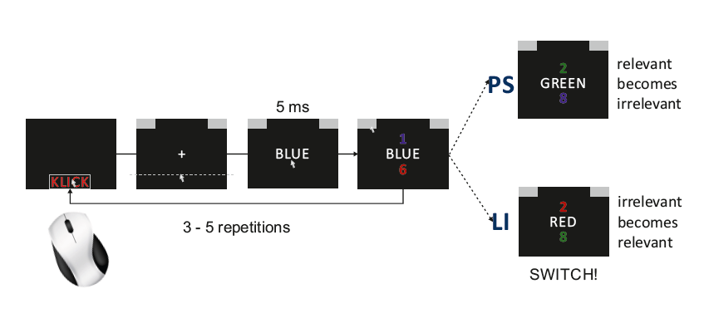
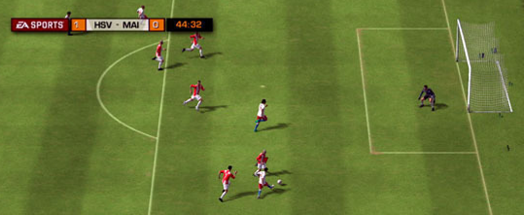
Areas of application Set-Shifting
(Dreisbach & Goschke, 2004;
Frisch, Dshemuchadse, Görner, Goschke, & Scherbaum, 2015)
Slide 33

Slide 32
Areas of application Set-Shifting
Frisch, Dshemuchadse, Görner, Goschke, & Scherbaum, 2015
Slide 37

Slide 33
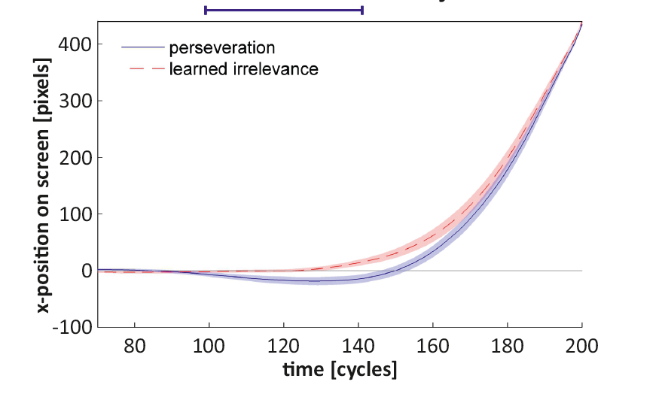
Areas of application Set-Shifting
Frisch, Dshemuchadse, Görner, Goschke, & Scherbaum, 2015
Slide 38

Slide 34
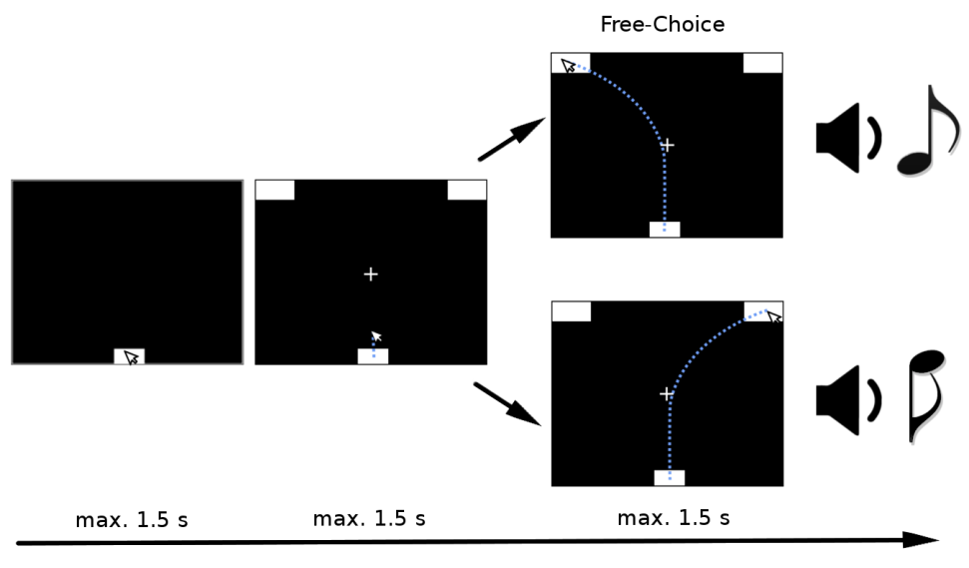
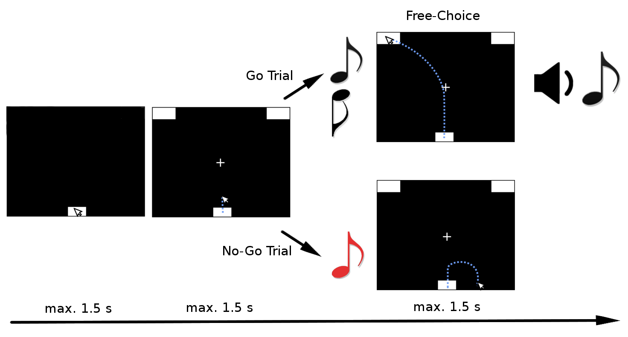
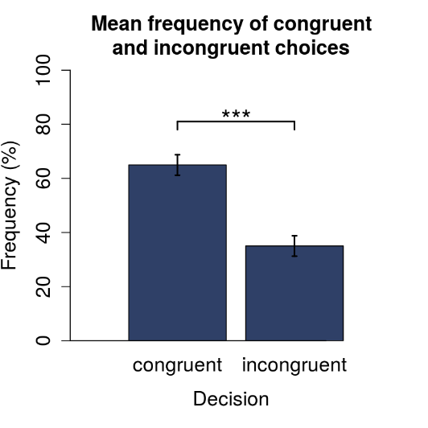
Areas of application Unwanted decision strategies in ideomotor learning
Learning
Testing: Will participants choose congruently?
Vogel, Scherbaum, Janczyk, 2018

Slide 35
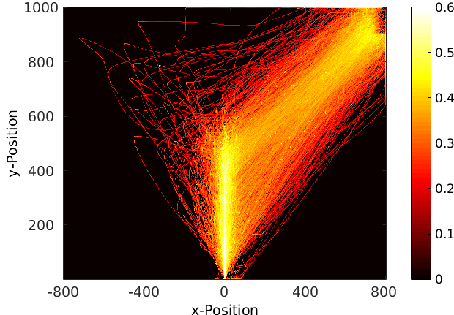
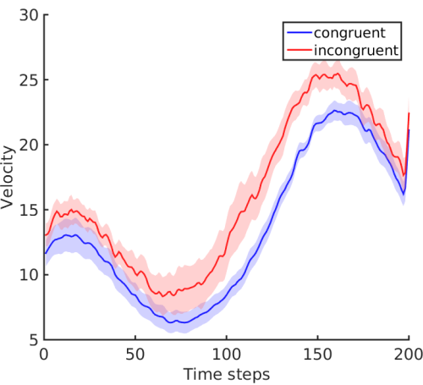
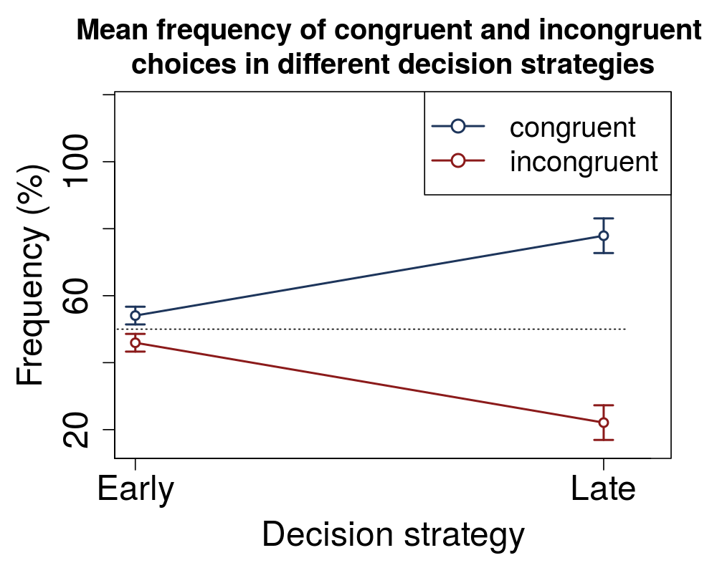
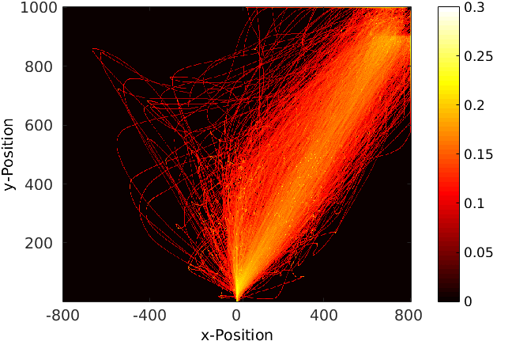
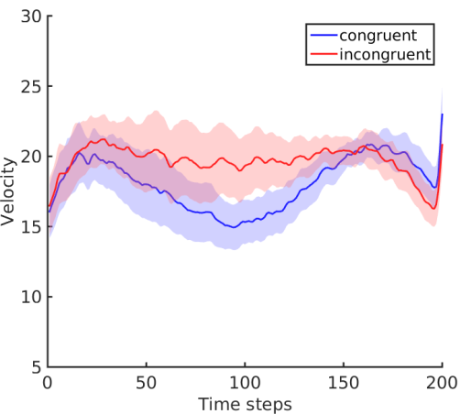
Areas of application Unwanted decision strategies in ideomotor learning
Late decision strategy
Early decision strategy
Vogel, Scherbaum, Janczyk, 2018

Slide 36
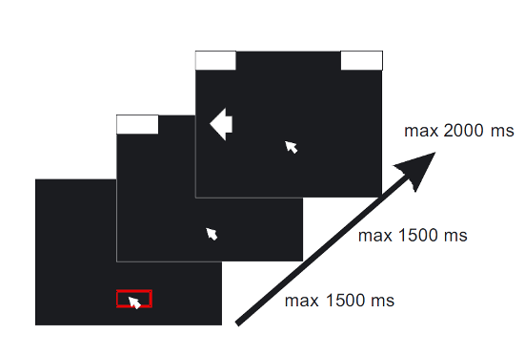
Areas of application Cognitive Control: Simon task and cognitive conflict
Simon, 1969
Scherbaum, Dshemuchadse, Fischer, Goschke, 2010

Slide 37
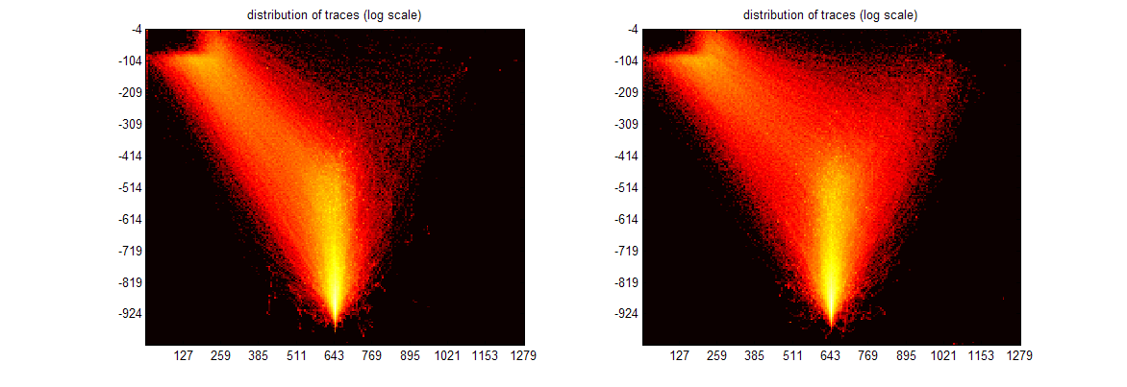
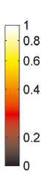
Areas of application Cognitive Control: Simon task and cognitive conflict
see also Ye & Damian, 2023

Slide 38
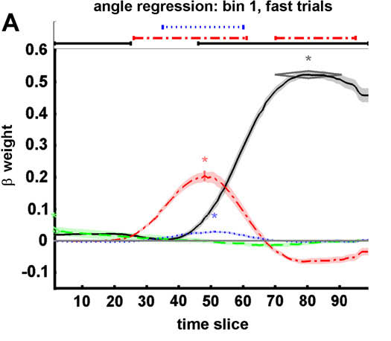
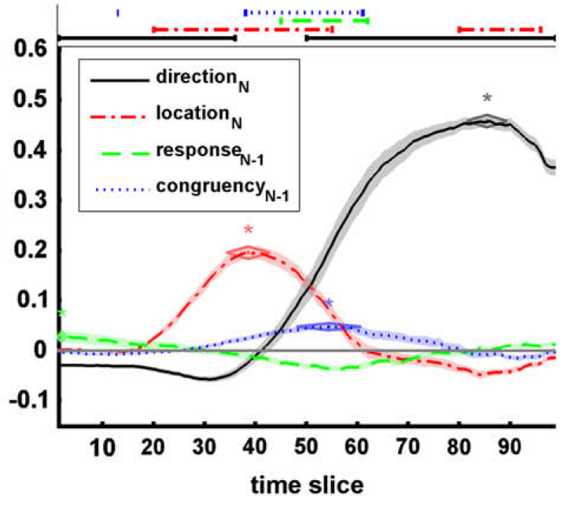
Areas of application Cognitive Control: Simon Task and cognitive conflict
Time course of influences in TCMR
Fast trials
Slow trials

Slide 39
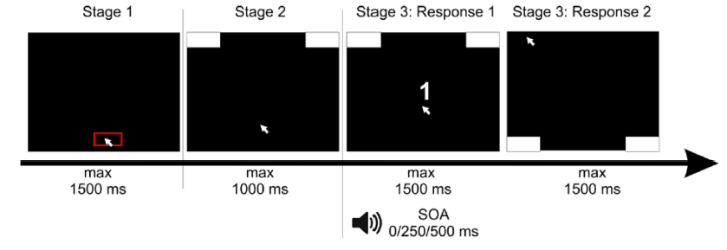
Areas of application Multitasking
Scherbaum, Gottschalk, Dshemuchadse, Fischer, 2015

Slide 40
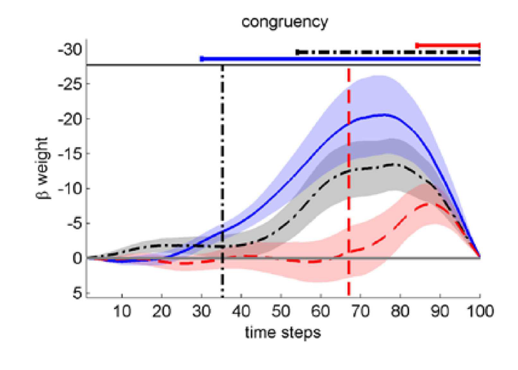
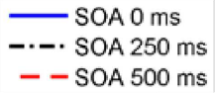
Areas of application Multitasking
Scherbaum, Gottschalk, Dshemuchadse, Fischer, 2015

Slide 41
What we will look at today
What will we do in the course?
Where has it been applied?
What can we look at?
What do we need to keep in mind?

Slide 42
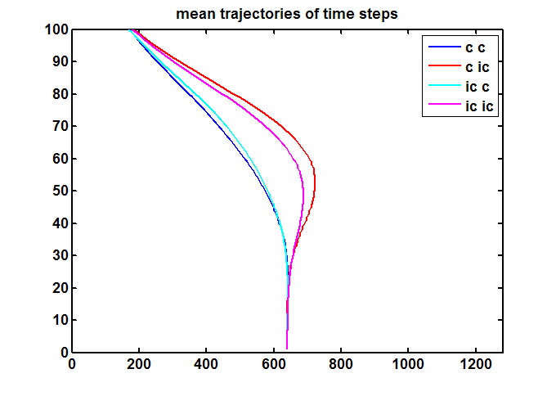
Methods of Analysis 2D Coordinates
Interpretation: Whatever you want to read into it qualitatively

Slide 43
Methods of Analysis Heat Maps
Interpretation: Consistency of movements and biases on movements

Slide 44
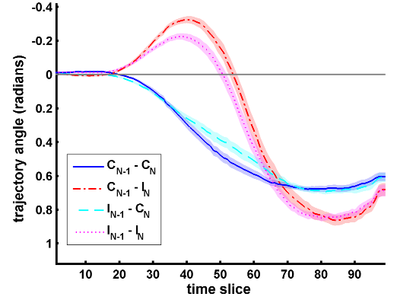
Methods of Analysis Trajectory Angle
Interpretation: Direct influences on movement direction

Slide 45
Methods of Analysis Velocity
Interpretation: Speed of processing, cognitive effort

Slide 46
Methods of Analysis Static measures: Area under curve, Maximum Deviation
AUC
MAD
Interpretation: Strength of conflict or bias

Slide 47
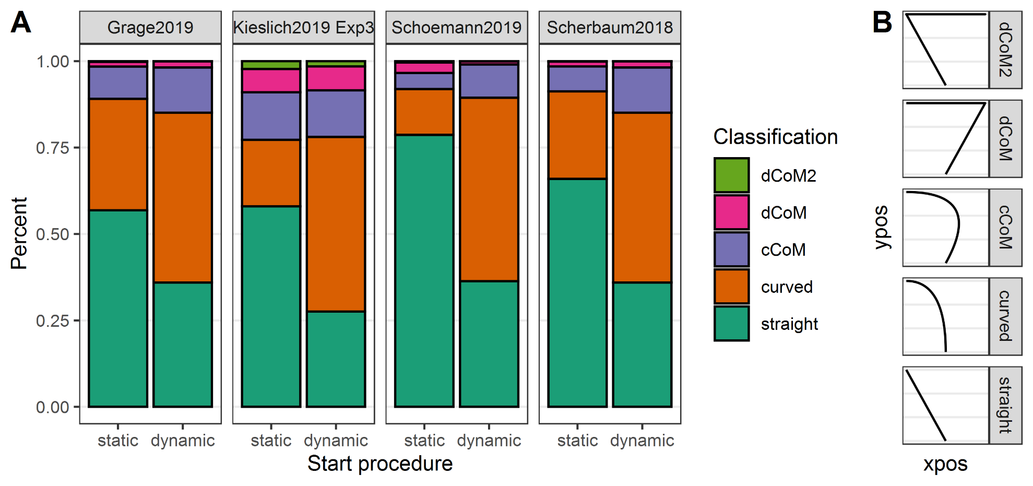
Methods of Analysis Movement Prototypes
Interpretation: Qualitity of conflict or bias / consistency of movements (/ dual systems)

Slide 48
Methods of Analysis Discrete changes of mind (dCoM) classification
Interpretation: Qualitity of conflict or bias / consistency of movements (/ dual systems)

Slide 49
Methods of Analysis Dissection of influences: Time-continuous regression
Direction
Location
prev. conflict
prev. response
Regression
Regression
Regression
Regression

Slide 50
Methods of Analysis Dissection of influences: Time-continuous regression
Interpretation: Strength of different influences at different points in time

Slide 51
Methods of Analysis Dissection of influences: Time-continuous regression & extraction of individual measures
Gauss fitting
Extracted β-weights from time-series data
Fitted β-weights
peak time
duration (SD)
peak
strength
Scherbaum & Dshemuchadse, 2020
Interpretation: Strength, duration and timing of different influences

Slide 52
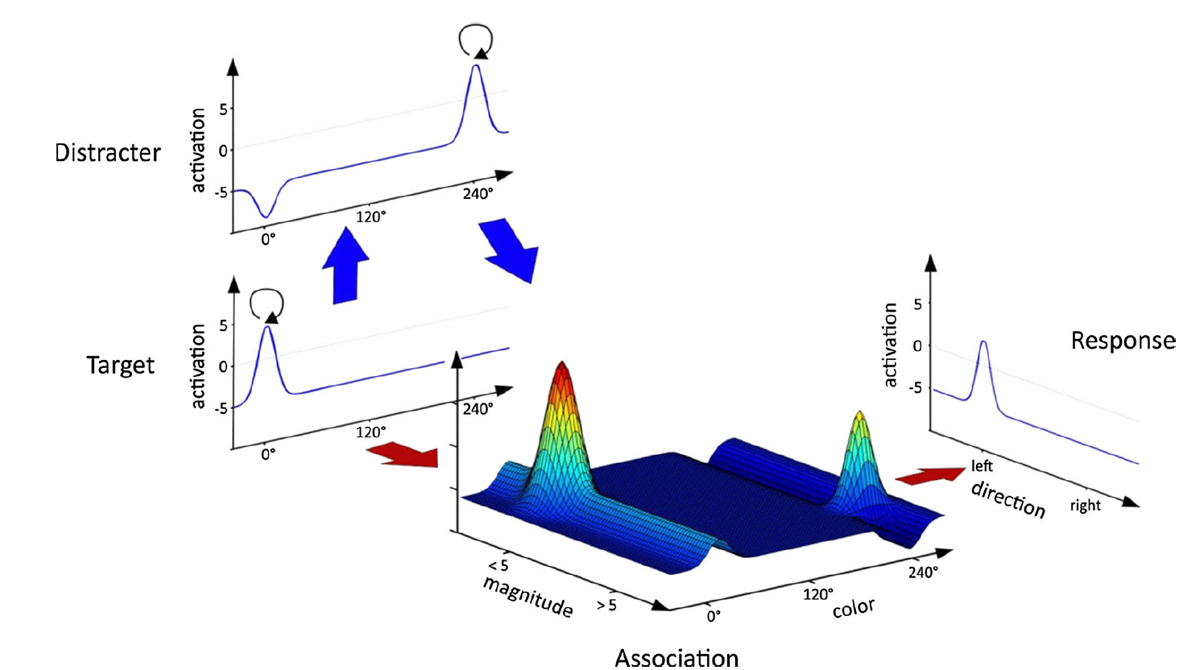
Methods of Analysis and Synthesis: Modelling trajectories
Dynamic Neural Field Model
Frisch, Dshemuchadse, Görner, Goschke, & Scherbaum, 2015

Slide 53
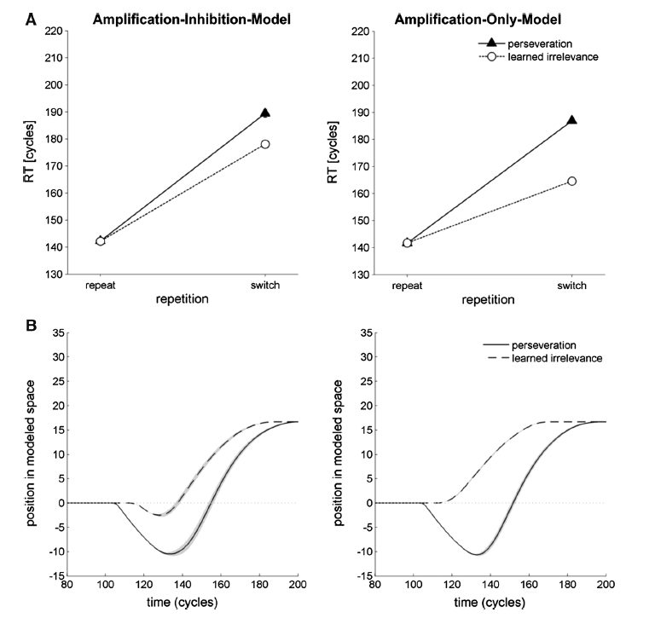
Methods of Analysis and Synthesis: Modelling trajectories
Predicted Movements
Frisch, Dshemuchadse, Görner, Goschke, & Scherbaum, 2015

Slide 54
Methods of Analysis and Synthesis: Modelling
Measured Movements
Frisch, Dshemuchadse, Görner, Goschke, & Scherbaum, 2015

Slide 55
Methods of Analysis and Synthesis: Modelling trajectories
SS = soon & small
LL = late & large
→ Stay easier than switch

Slide 56
Methods of Analysis and Synthesis: Modelling trajectories
Neural attractor model
Measured movements
Modelled state-space trajectories

Slide 57
Toolboxes for these analyses
Matlab: TCMR Toolbox
https://osf.io/5e3vn/
R: Mousetrap
https://cran.r-project.org/web/packages/mousetrap/

Slide 58
What we will look at today
What will we do in the course?
Where has it been applied?
What can we look at?
What do we need to keep in mind? → The black art of mouse tracking

Slide 59
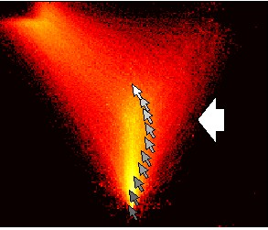
The black art of mouse tracking Issues of experimental design
Slide 29

Slide 60
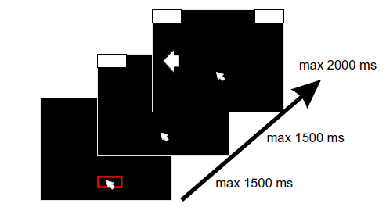
Issues of experimental design Issue 1: What triggers stimuli
Participants need to move while thinking
Force them to move & present stimuli only after movement started
Instruct them to move continuously
→Check for continuous movements and exclude stopping participants
good
Y Axis
Diff(Y Axis)
bad
Y Axis
Diff(Y Axis)

Slide 61
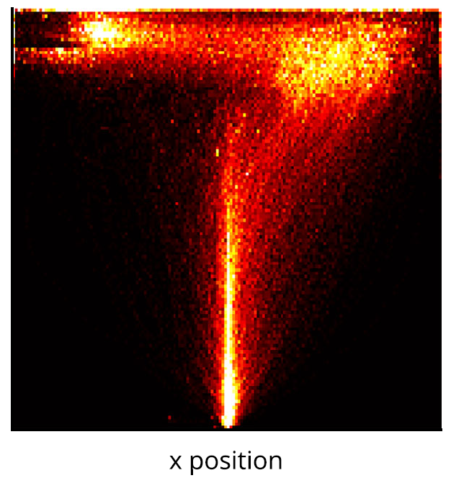
Issues of experimental design Issue 2: Touching/hover or clicking
Use the power of ballistic movements
Make choice movement as intuitive as possible
Avoid irritation by clicking into target boxes or too small boxes
Grage, Schoemann, Kieslich, Scherbaum, 2019

Slide 62
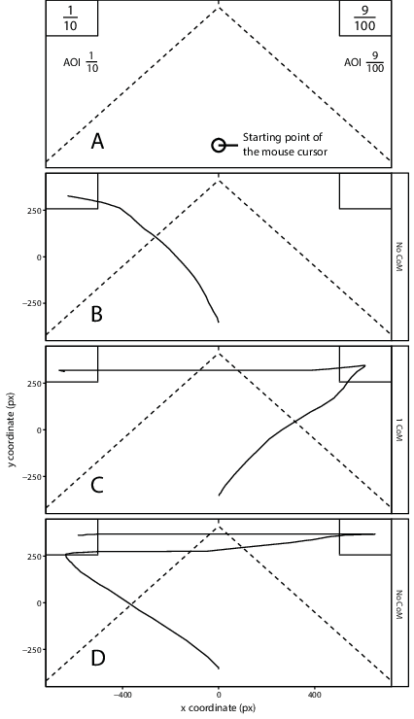
Issues of experimental design Issue 2: Touching/hover or clicking
Or maybe you want re-decisions? Then clicking is good
Szaszi, Palfi, Szollosi, Kieslich, Aczel, 2018

Slide 63
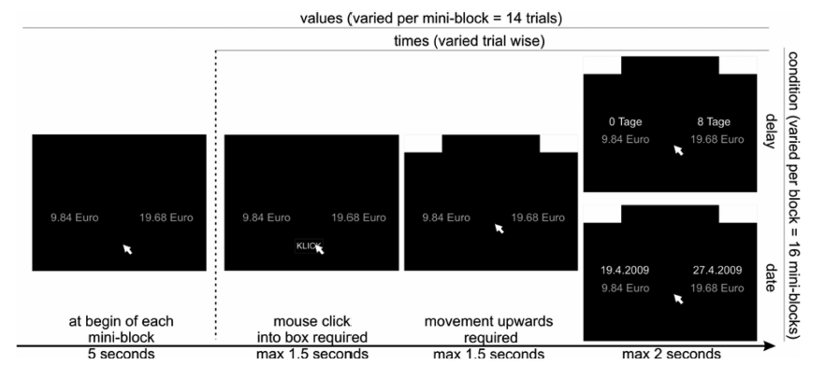
Issues of experimental design Issue 3: Complexity of task
Participants will stop moving or move backwards when decision is too complex → study simple decision or simplify the decision
Dshemuchadse, Scherbaum, Goschke, 2012

Slide 64
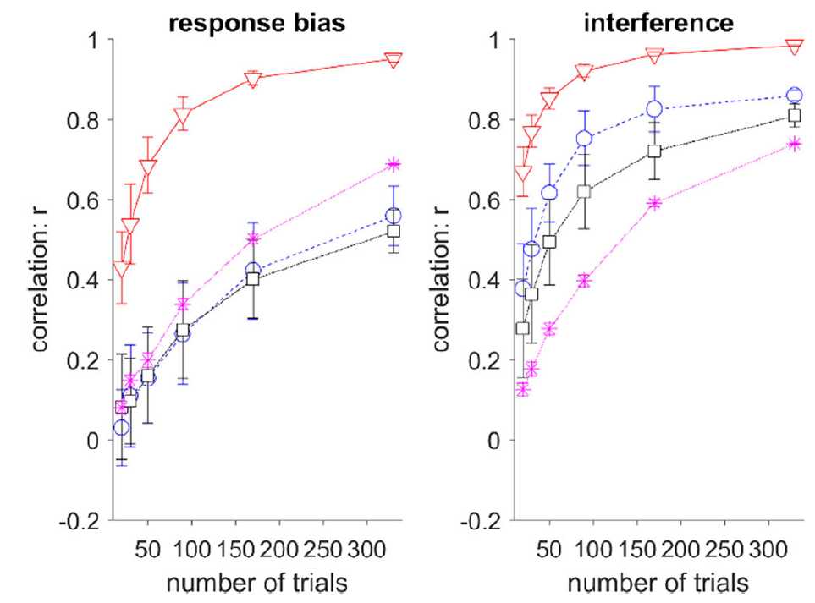
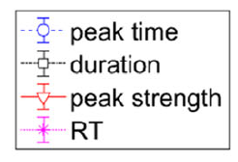
Issues of experimental design Issue 4: Have enough trials
Scherbaum, Dshemuchadse, 2020

Slide 65
The black art of mouse tracking Issues of data analysis

Slide 66
Issues of data analysis Issue 5: Choose your trajectory measure
Continuous movements can be analyzed in different ways
X-Y Movements
Movement on X-Axis
Angle to Y-Axis
Speed
Deviation
Euclidian distance

Slide 67
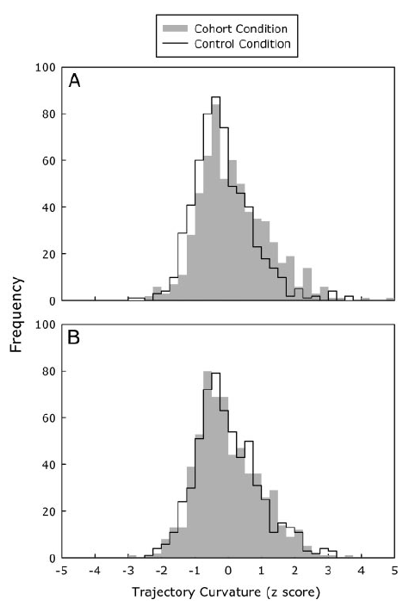
Issues of data analysis Issue 6: Bimodality
Countermeasure
Histograms of MAD or AUC
Bimodality index on max/mean deviation
Sexy & functional: Heat maps
Grage, Schoemann, Kieslich, Scherbaum, 2019
Spivey et al., 2005

Slide 68


Issues of data analysis Issue 7: Time normalization?
What is the process of interest?
Stimulus locked
Response locked
Center locked
Time normalized

Slide 69

Issues of data analysis Issue 8: Regression - Multicolinearity
When trial properties are dependent due to Bad design or Post-hoc factors
Direction
Location
Previous conflict
Previous response
Regression
Regression
Regression
Regression

Slide 70

Issues of data analysis Issue 8: Regression - Multicolinearity
Counter measures:
Covariance/correlation of trial properties
Variance inflation factor (https://en.wikipedia.org/wiki/Variance_inflation_factor)
Stepwise regression
(Scherbaum et al., 2016)

Slide 71
The black art of mouse tracking A bunch of (hidden) choices
Aim to understand your method and the assumptions!
Experimental Design
Stimuli triggers, Touching or clicking, Task complexity, Number of trials
Data Analysis
Trajectory measures, Statistical measures, Bimodality, Multicolinearity

Slide 72
Summary
Mouse tracking is a cheap method that lets us get a lot out of behavioral data from 2 alternative forced choice tasks
Methods of analysis can go from simple (qualitative or maximum deviation) to complex (TCMR)
You need to consider several design factors when designing your experiment
Until tomorrow:
Talk about potential experiments and interests in groups. Decide which package you want to choose. → Check to Google Slides → Install R, Matlab, Open Sesame

